Slide 1
an gentle introduction to StupidAlgorithm Library
Yi Liu(john.rockmania@gmail.com)

Slide 2
Outline
introduction
test function example
demonstration
future improvement and directions

Slide 3
What is StupidAlgorithm Library
an lightweight,cross-platform and real-valued c++ evolutonary computation algorithm library under developing
motivation:automation of ec algorithms experiments and assessment of algorithm portfolio.
it provide you a blackbox which can help you to choose the best among your algorithm portfolio

Slide 4
Major Features
batch run scripts,algorithm statisticals datas generation and fine-tune ability ALL through configuration file.
5 types of evolutionary algorithm PSO,DE,FEP currently.
22 algorithms,24 benchmark functions,4 types of termination criterion,3 types of initialization method reside.
Multi-thread tasking among different parameter-combinations/algorithms.

Slide 5
a partial comparison
Library | EO | StupidAlgorithm
Major implementation technique | Template | Virtual Function
Concurrency | NO | Thread pool
Functionality | Enhanced features and extensibility | Decent
hybrid of algorithms | supported and complicated(complex syntax) | NO(currently)
algorithms experiment automation | NO | Configurable script,statistics report generation
programmer-friendiness | Oops,template :( | :)

Slide 6
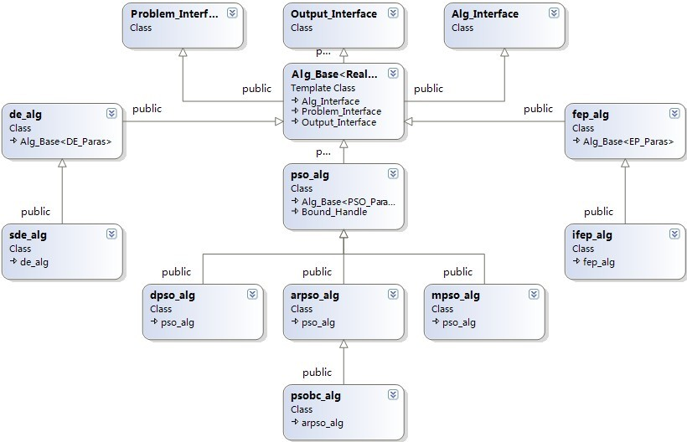
Hierarchy of Library
an approximation of "Strategy" Design Pattern
*minimum usage of template technique in C++
Conform to the ISO C++ 0x standard

Slide 7
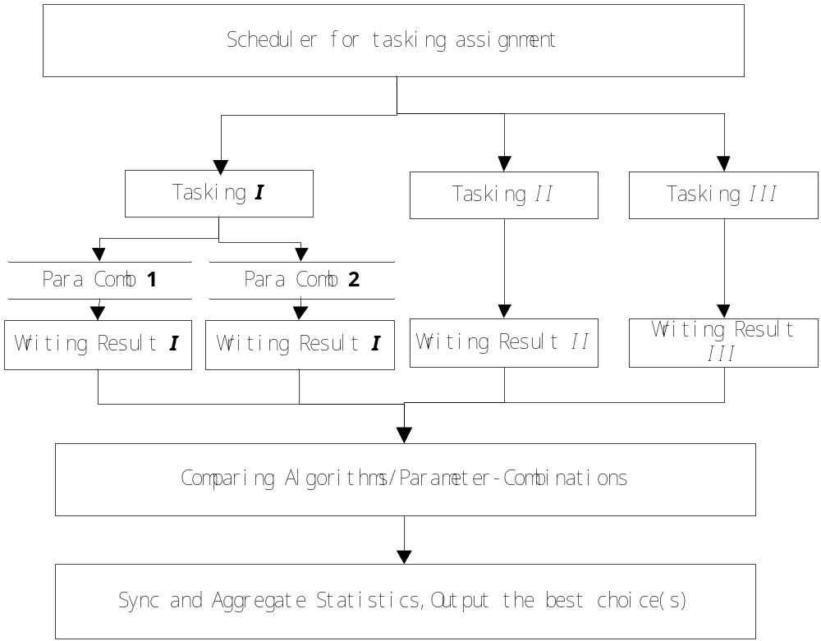
Multi-Threaded Tasking

Slide 8
What can we learn by experiment
Experiment settings:
All tested algorithms used the same initial population
Population size equal to 20.
All statistic data are all averaged over 20 runs.
Termination criterion:
  1. maximum function evaluation number equals 10000
  2. maximum stagnation generation number equals 500.

Slide 9
an example of batch run scripts
# batch run configuration file
#
# format:
# algorithm_number config_file_path
# algorithm_number:
# 1: standard PSO algorithm
# 2: mPSO algorithm
# 3: arPSO algorithm
# 4: dPSO algorithm
# 5: my dPSO algorithm
# 6：PSObc algorithm
# 7：DE algorithm with basic extension
# 8：self-adaptive DE algorithm
# 9：Fast Evolutionary Programming algorithm
# 10:Improved Fast Evolutionary Programming algorithm
# '-' means same config_file_path with previous item
1 parameters_F5.txt
#2 parameters_F5.txt
#3 parameters_F5.txt
4 parameters_F5.txt
#5 Parameters_F5.txt
#6 parameters_F5.txt

Slide 10
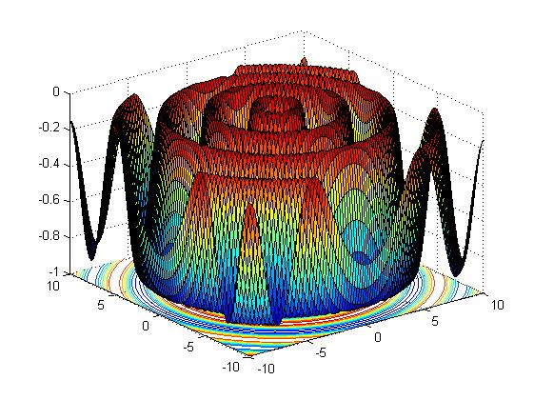
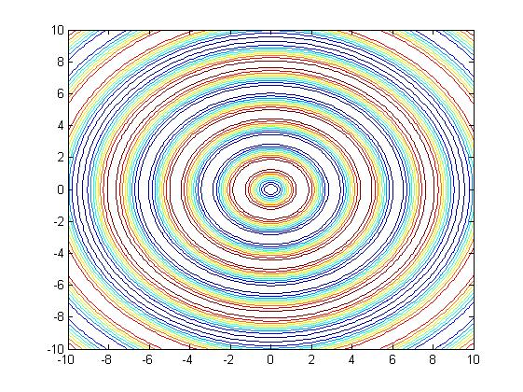
Test Example:Function F5
two-dimensional,multi-modal, global minimum:x=(0,0),y=-1,infinite sub-optimum solutions around area -0.990284...

Slide 11
performance index
algo_number | best | worst | avg_val | std | conv_count | conv_ratio | avg_time | eval_count
pso | -1 | -0.990284 | -0.997085 | 0.00445233 | 13 | 0.65 | 0.5031 | 200000
dpso | -1 | -0.990284 | -0.998946 | 0.00290886 | 13 | 0.65 | 0.97085 | 200175
de | -1 | -0.990284 | -0.997479 | 0.0037671 | 5 | 0.25 | 1.0671 | 200000
fep | -1 | -0.990283 | -0.993777 | 0.00420299 | 0 | 0 | 2.69085 | 200000

Slide 12
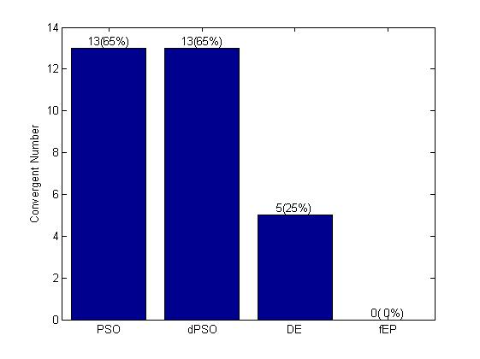
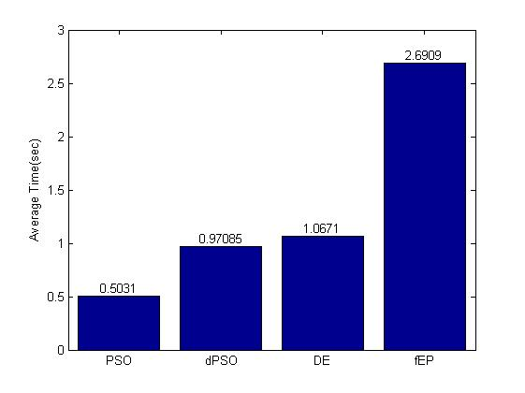
Auto-generated algorithm portfolio evaluation
all bar graph are averaged through 20 runs

Slide 13
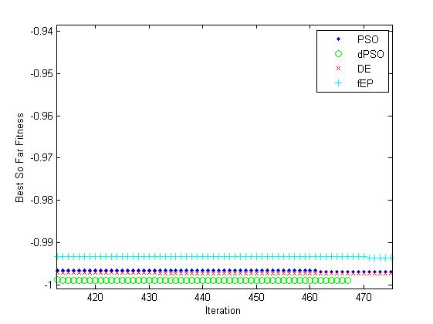
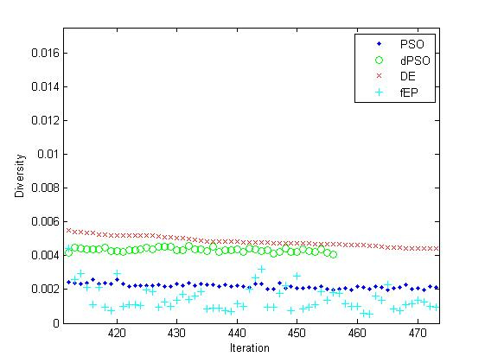
Auto-generated quality and diversity comparison
all curve graph are averaged through 20 runs

Slide 14
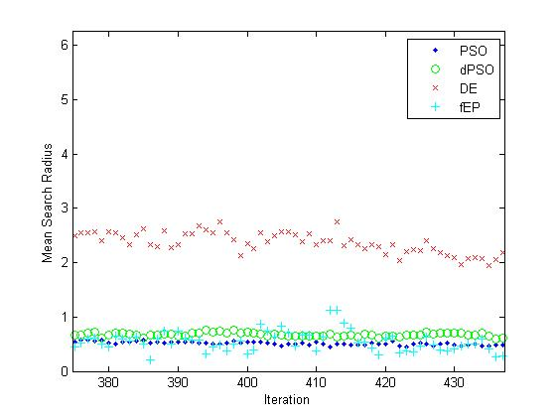
Auto-generated average search radius comparison

Slide 15
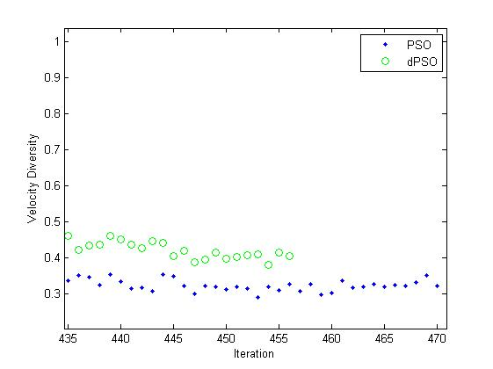
Observation:dpso is better than pso
velocity diversity and position diversity is closed related in pso algorithm
dpso has higer diversity and velocity diversity than pso in f5,althrough the quality of solution is no better than the latter.

Slide 16
Curiosity:change the termination criterion,rerun the test
algo_number | best | worst | avg_val | std | conv_count | conv_ratio | avg_time | eval_count | avg_gen
pso | -0.558092 | -0.508497 | -0.520312 | 0.0107451 | 0 | 0 | 0.62335 | 223680 | 559.2
dpso | -0.990284 | -0.514987 | -0.719563 | 0.173794 | 0 | 0 | 1.29775 | 263031 | 628.75
de | -1 | -0.990284 | -0.998543 | 0.00346927 | 17 | 0.85 | 3.1361 | 492660 | 1231.65
fep | -1 | -0.990284 | -0.99361 | 0.00419146 | 3 | 0.15 | 7.333 | 500980 | 1252.45

Slide 17
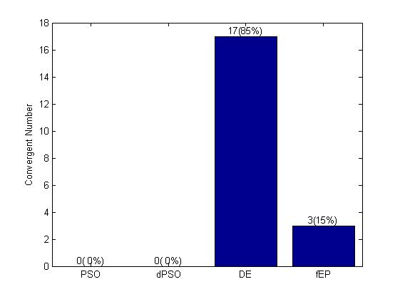
what happen to PSO?
BEFORE
AFTER

Slide 18
F5 Test Example Observation:
PSO Algorithm is susceptible to max iteration number parameter,and termination criterion is set to run until stagnation ,hence no appropriate max iteration number is set for the specific problem.
DE is the most simple algorithm as parameter tuning complexity is concerned(almost parameter-free),it has the highest diversity and mean search radius also.
EP is the most random and unstable algorithm.

Slide 19
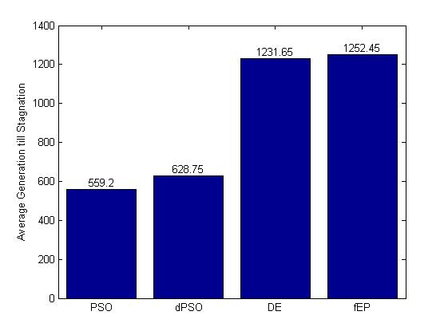
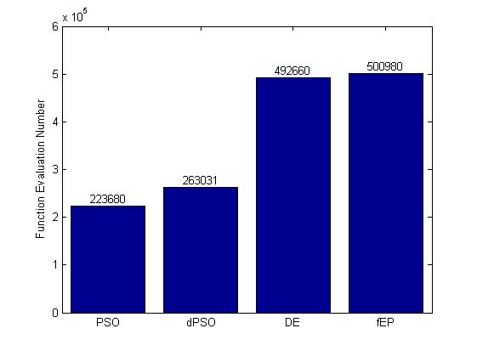
Auto-generated Algorithm Sustainability Comparison

Slide 20
Auto-generated algorithms comparison stat among DE algo
 | eDE | dmDE | DE/EDA | EDA | spDE | jDE
Rosenbrock | 0(0%) | 0(0%) | 0(0%) | 0(0%) | 0(0%) | 0(0%)
M_foxhole | 0(0%) | 0(0%) | 0(0%) | 0(0%) | 0(0%) | 0(0%)
M_langerman | 0(0%) | 0(0%) | 0(0%) | 0(0%) | 0(0%) | 0(0%)
M_michaelwicz | 0(0%) | 0(0%) | 0(0%) | 0(0%) | 0(0%) | 0(0%)
Step | 30(100%) | 30(100%) | 2(6.6667%) | 30(100%) | 30(100%) | 30(100%)
Rosenbrock | 0(0%) | 0(0%) | 0(0%) | 0(0%) | 0(0%) | 0(0%)
Quartic_with_noise | 0(0%) | 0(0%) | 0(0%) | 0(0%) | 0(0%) | 0(0%)
F8 | 0(0%) | 0(0%) | 0(0%) | 0(0%) | 0(0%) | 0(0%)
Rastrigin | 0(0%) | 0(0%) | 0(0%) | 0(0%) | 0(0%) | 0(0%)
Ackey | 0(0%) | 0(0%) | 0(0%) | 0(0%) | 0(0%) | 0(0%)
Griewank | 0(0%) | 0(0%) | 0(0%) | 9(30%) | 0(0%) | 0(0%)
F12 | 0(0%) | 0(0%) | 0(0%) | 0(0%) | 0(0%) | 0(0%)
F13 | 0(0%) | 0(0%) | 0(0%) | 0(0%) | 0(0%) | 0(0%)
Camelback | 0(0%) | 0(0%) | 0(0%) | 0(0%) | 0(0%) | 0(0%)
F14 | 0(0%) | 0(0%) | 0(0%) | 0(0%) | 0(0%) | 0(0%)
F15 | 0(0%) | 0(0%) | 0(0%) | 0(0%) | 0(0%) | 0(0%)

Slide 21
F5 example conclusion:No Free Lunch
As far as F5 is concerned:
pso is the best among tested algorithms as to convergent rate and speed,but it is very sensitive to max iteration number(unique and additional parameter).
de is the best trade-off choice in F5 verified by two-tailed t-test.
fep is the most sustainable/random algorithm among tested algorithms according to sustainability stat and plotting.

Slide 22
Future Improvement and Challenge
open questions:
Design Pattern:
To improve the abstractness of class hierarchy,
how to separate virtual function and template in same base class?
Algorithm:
  Why fep algorithm is so slow in practice?it is caused by its special tournament selection procedure?
  How to hybrid two different kind algorithm according to experiment datas and analysis?

Slide 23
Q & A
StupidAlgorithm library is open source and immature by and large,checkout http://code.google.com/p/StupidAlgorithmrithm
and leave your critiques.
your participation and code review(algorithm performance optimization/code revision) will be appreciated.

